Slide 1

PowerShell 5.0
A Brave New World
#MVPHour
#CDNMVPDays
@EnergizedTech
@MrThomasRayner

Slide 2

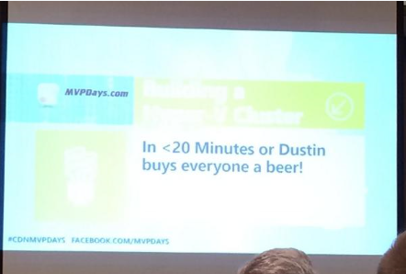


Don’t forget to tweet #CDNMVPDays and Win

Slide 3
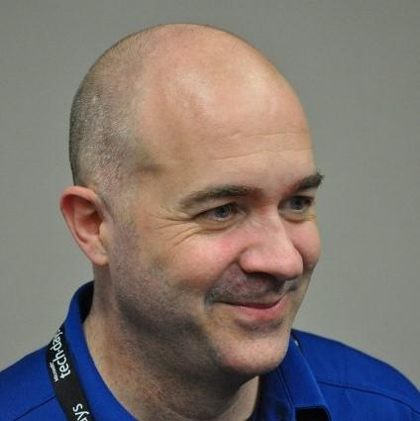
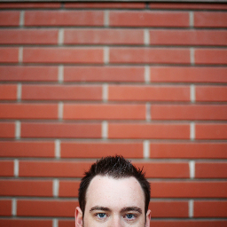
Who’s are these guys?
Sean Kearney, MVP
Senior Solutions Architect at Cistel Technology Inc.
Something Sean wants to plug, other creds (Honorary Scripting Guy)
Something else Sean wants to plug (a blog?)
Twitter: @EnergizedTech (Other ways Sean wants to be contacted, FB?)
Thomas Rayner, MVP
Systems Admin, NAIT Instructor
Edmonton Microsoft User Group – emug.ca – Sign up for our mailing list
Blog: workingsysadmin.com – links and slides will be uploaded tomorrow
Twitter: @MrThomasRayner LinkedIn: linkedin.com/in/thomasrayner

Slide 4
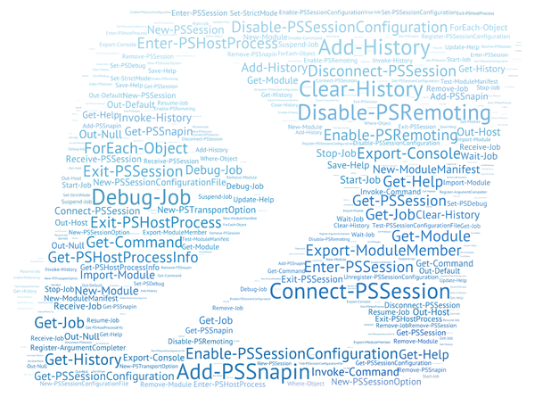
Did you know there’s a new version of PowerShell?

Slide 5
Buckle up

Slide 6
Questions? Connect with us. Don’t forget to tweet using #CDNMVPDays.
Sean Kearney
Thomas Rayner
Something Sean wants to plug, other creds (Honorary Scripting Guy)
Something else Sean wants to plug (a blog?)
Twitter: @EnergizedTech
(Other ways Sean wants to be contacted, FB?)
Edmonton Microsoft User Group – emug.ca – Sign up for our mailing list
Blog: workingsysadmin.com – links and slides will be uploaded tomorrow
Twitter: @MrThomasRayner
LinkedIn: linkedin.com/in/thomasrayner
Email: ThmsRynr@outlook.com

